Slide 1
Predicting Food Scarcity Risk
Notes:
Access to consistent nutritional food sources is a critical issue in America and throughout the world. The government in the United States allocates federal funds to states to help vulnerable populations.

Slide 2
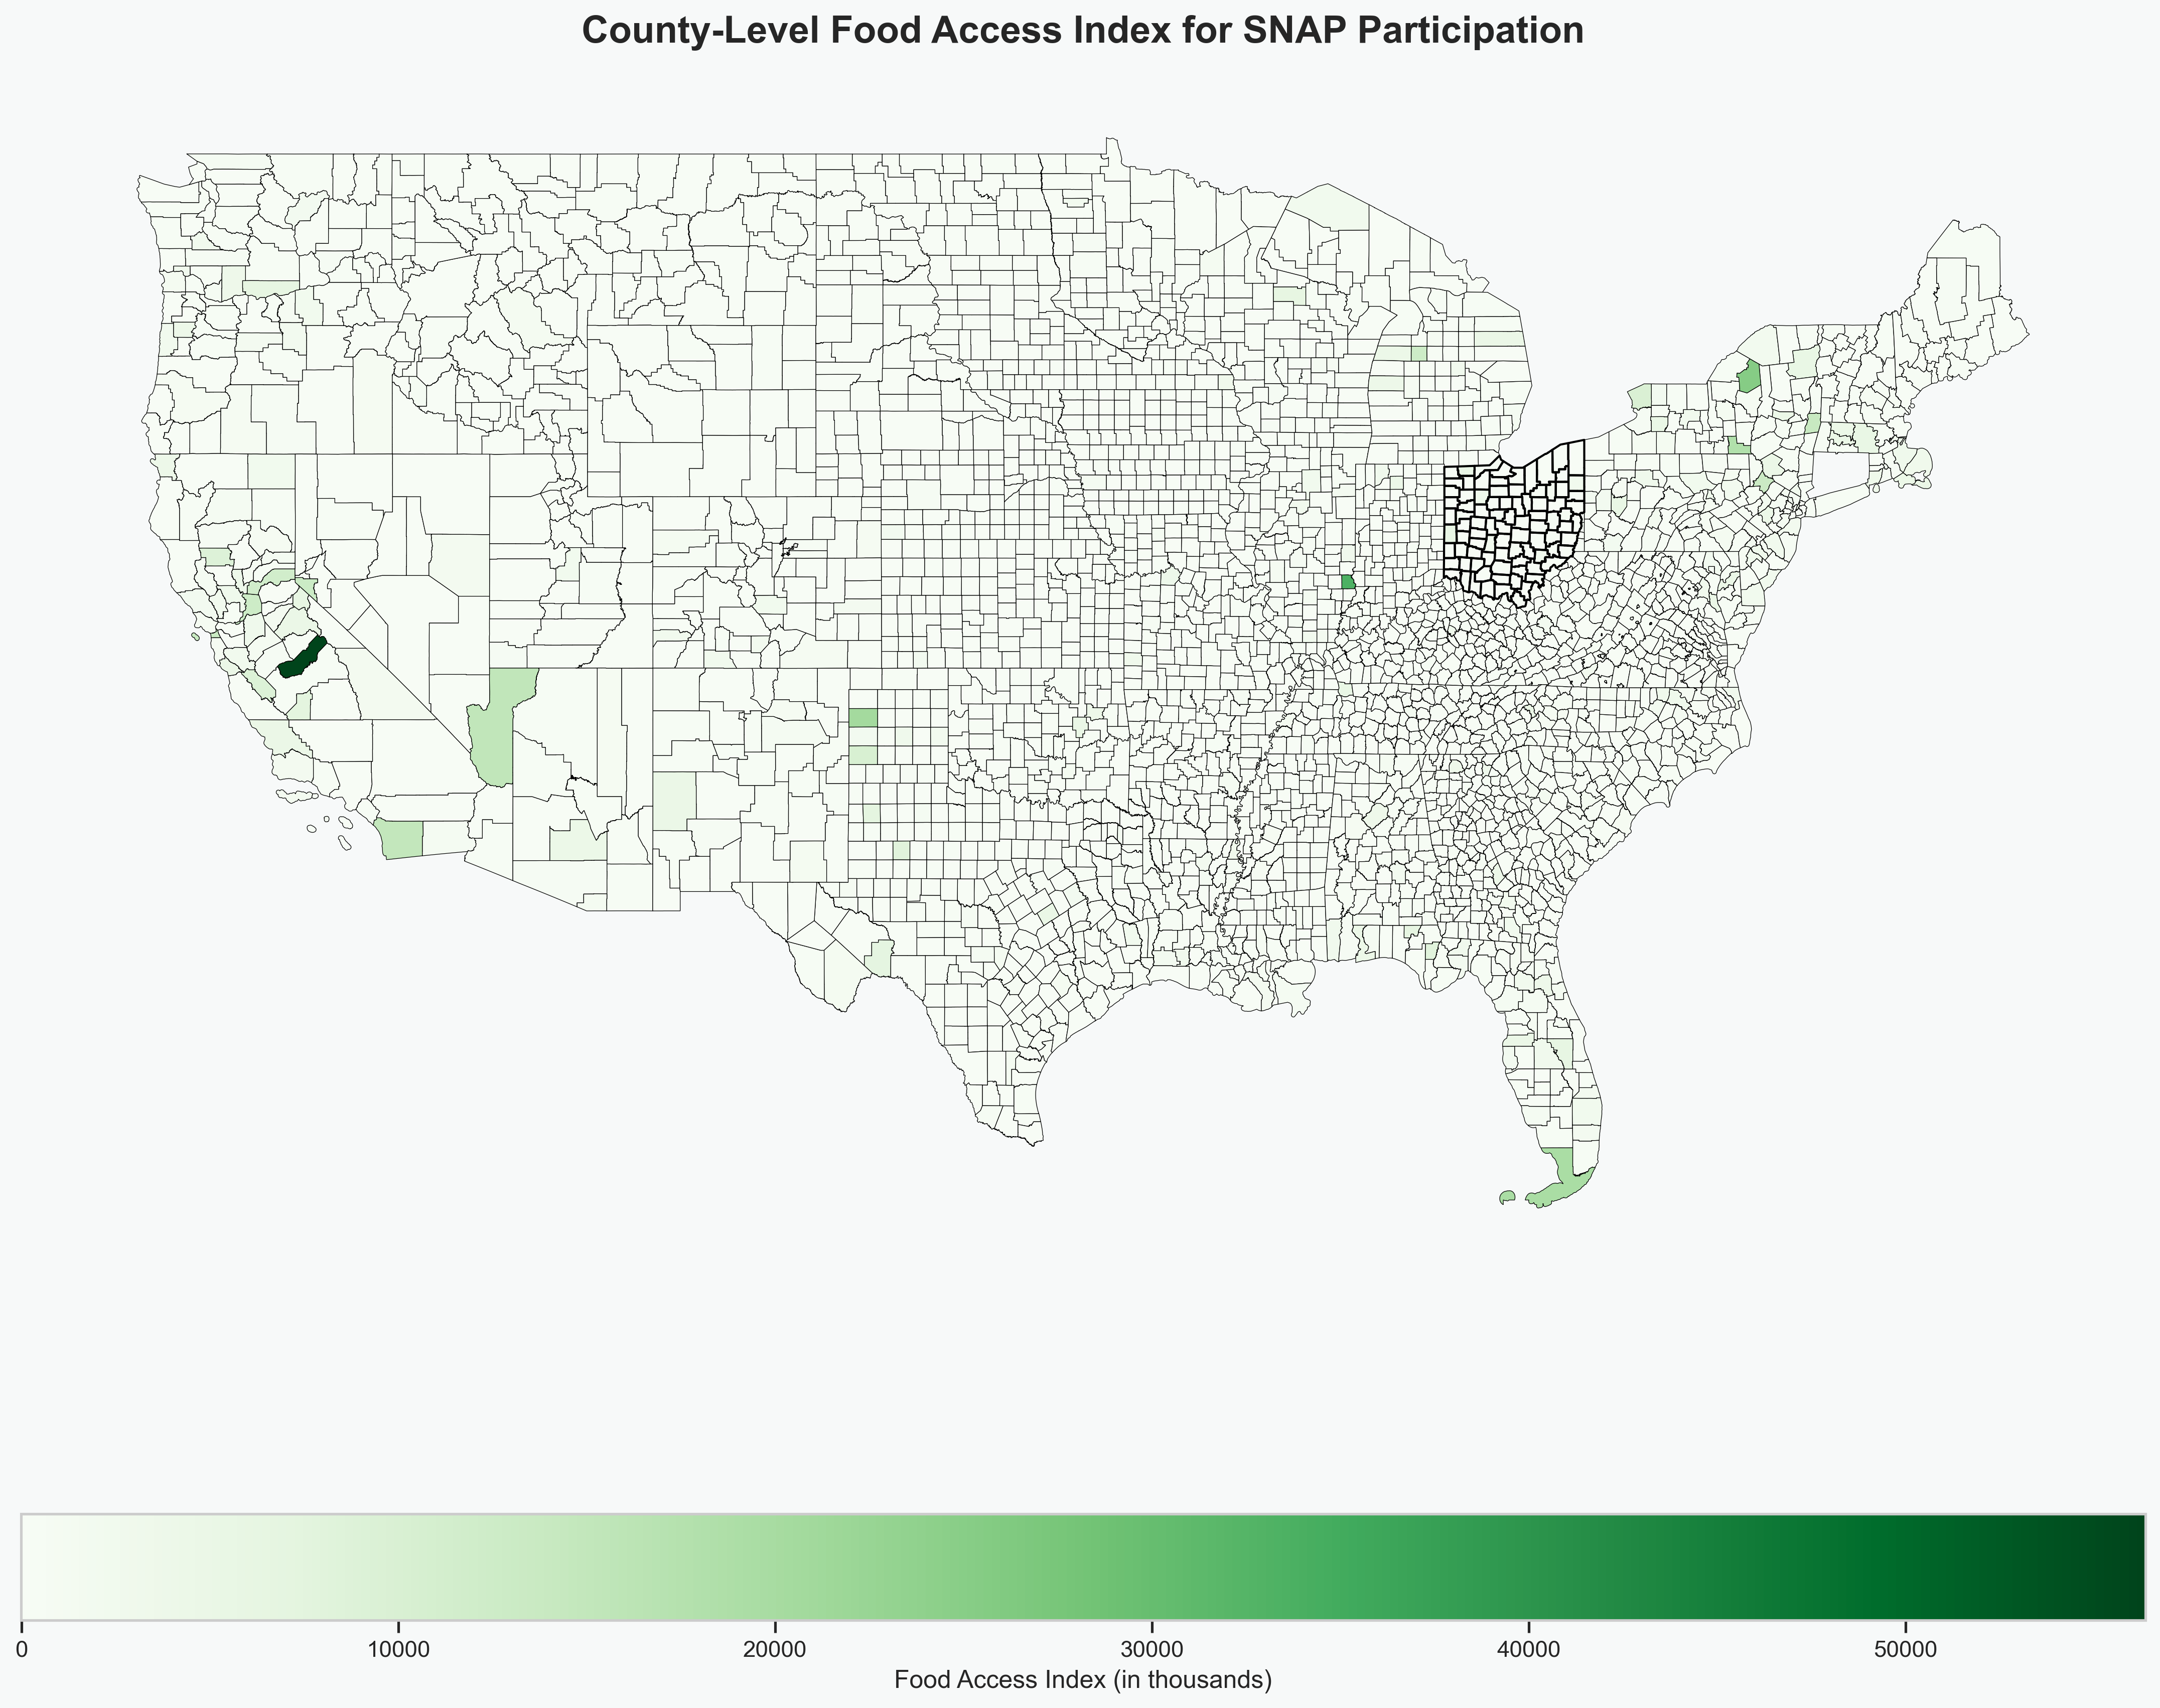
Notes:
By targeting where funds are needed, these allocated funds can be put to maximum use with reduced waste. SNAP helps millions of people each year. We are focusing on Ohio counties for this analysis since it has a mix of both urban and rural areas.. The chart shows that a higher index indicates better access to nutritional food. Ohio is close to the national average in SNAP participants and access to nutritional food, so the expectation is that creating a predictive model to anticipate food need by county in Ohio could later be applied to any state.

Slide 3
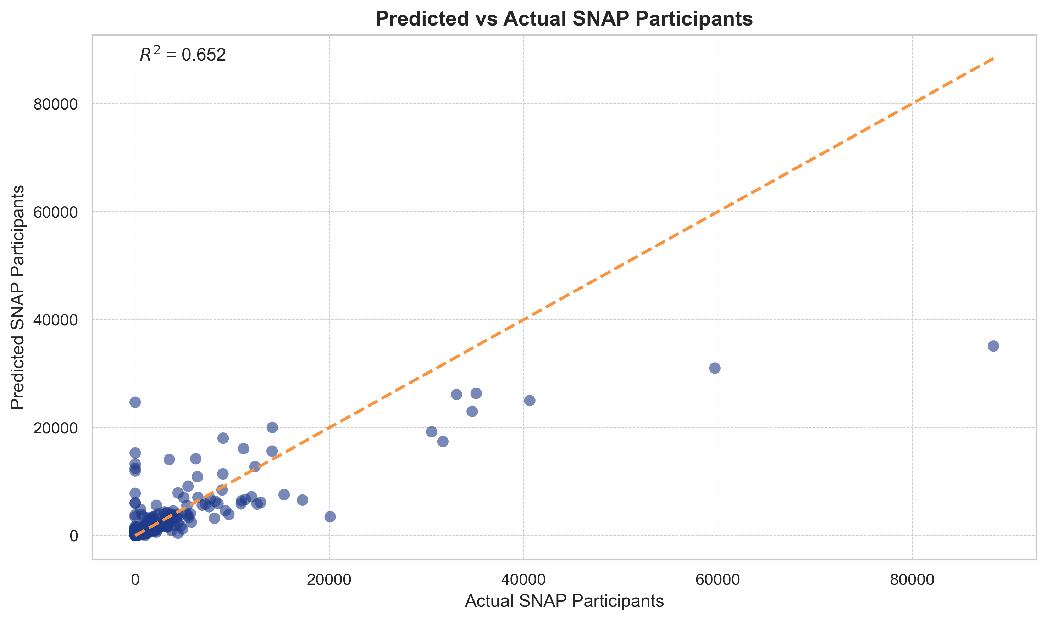
United States Department of Agriculture (USDA)
SNAP participation
Derived Food Access Index from SNAP related data from 2023
County – level poverty data
Notes:
Data was gathered from the United States Department of Agriculture at the county level, so no personally identifiable information was used. We will be predicting rising food needs to use for short-term future planning of federal SNAP benefits.

Slide 4
Merged Datasets
State / County level FIPS Code
Preprocessed and Transformed data
Imputed missing values with median
Data format consistency
Feature Engineering
Encoded categorical variables
Created lag metrics of SNAP participants
Random Forest Regressor Model
80% Training / 20 % Testing data split
Results
R² = 0.652
MAE = ~ 928
RMSE = ~ 3375
Notes:
We began by merging the datasets on FIPS code, which is a unique identifier that is assigned to each state and county. We used the median to fill in missing values in records and ensured data formats were consistent to use for machine learning. We encoded the categorical variables and created lag metrics of SNAP participants to use in training the Random Forest Regressor model. We split the data so we could use 80% of it to train the model and then the remaining 20% was used to test the predictive power of the model. The R-squared results show that the model can account for about 65% of the variability in changes in predicted SNAP participation. The Mean Absolute Error shows that the predictions differ by about 928 SNAP participants than the actual number. The Root Mean Squared Error shows that although predictions are within 1,000 participants, outliers could have predictions off by over 3,300 participants. The model is performing reasonably well at making predictions of food need.

Slide 5
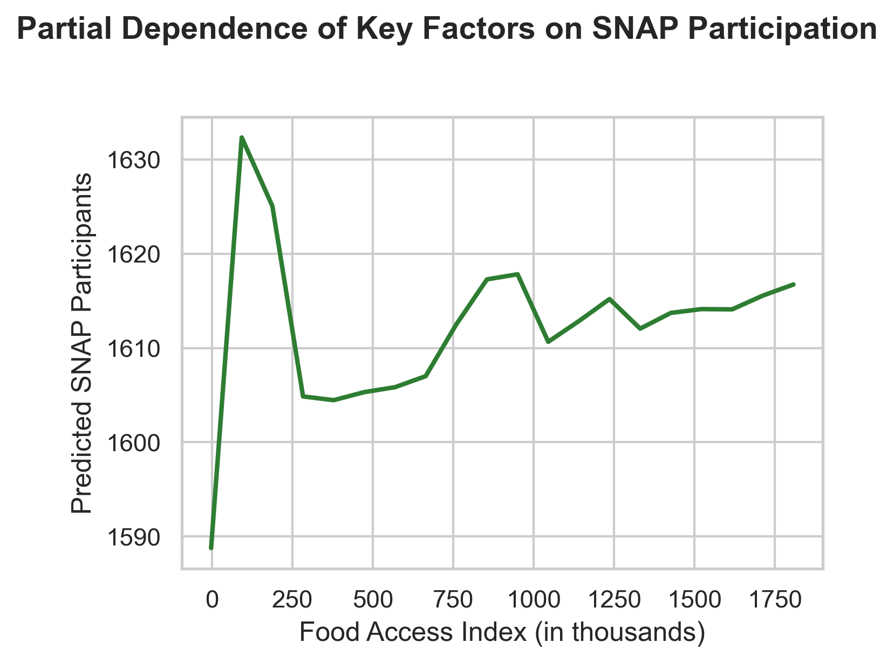
Notes:
A partial dependence chart is used to show the change in predictions when one feature changes and all other features were averaged to remain consistent. This chart’s sudden drop from its peak indicates that when access to food is very low, even small changes in access to food can decrease SNAP participants. It also shows that as access to nutritional food improves there begins to be a smaller amount of influence on the change of SNAP participants.

Slide 6
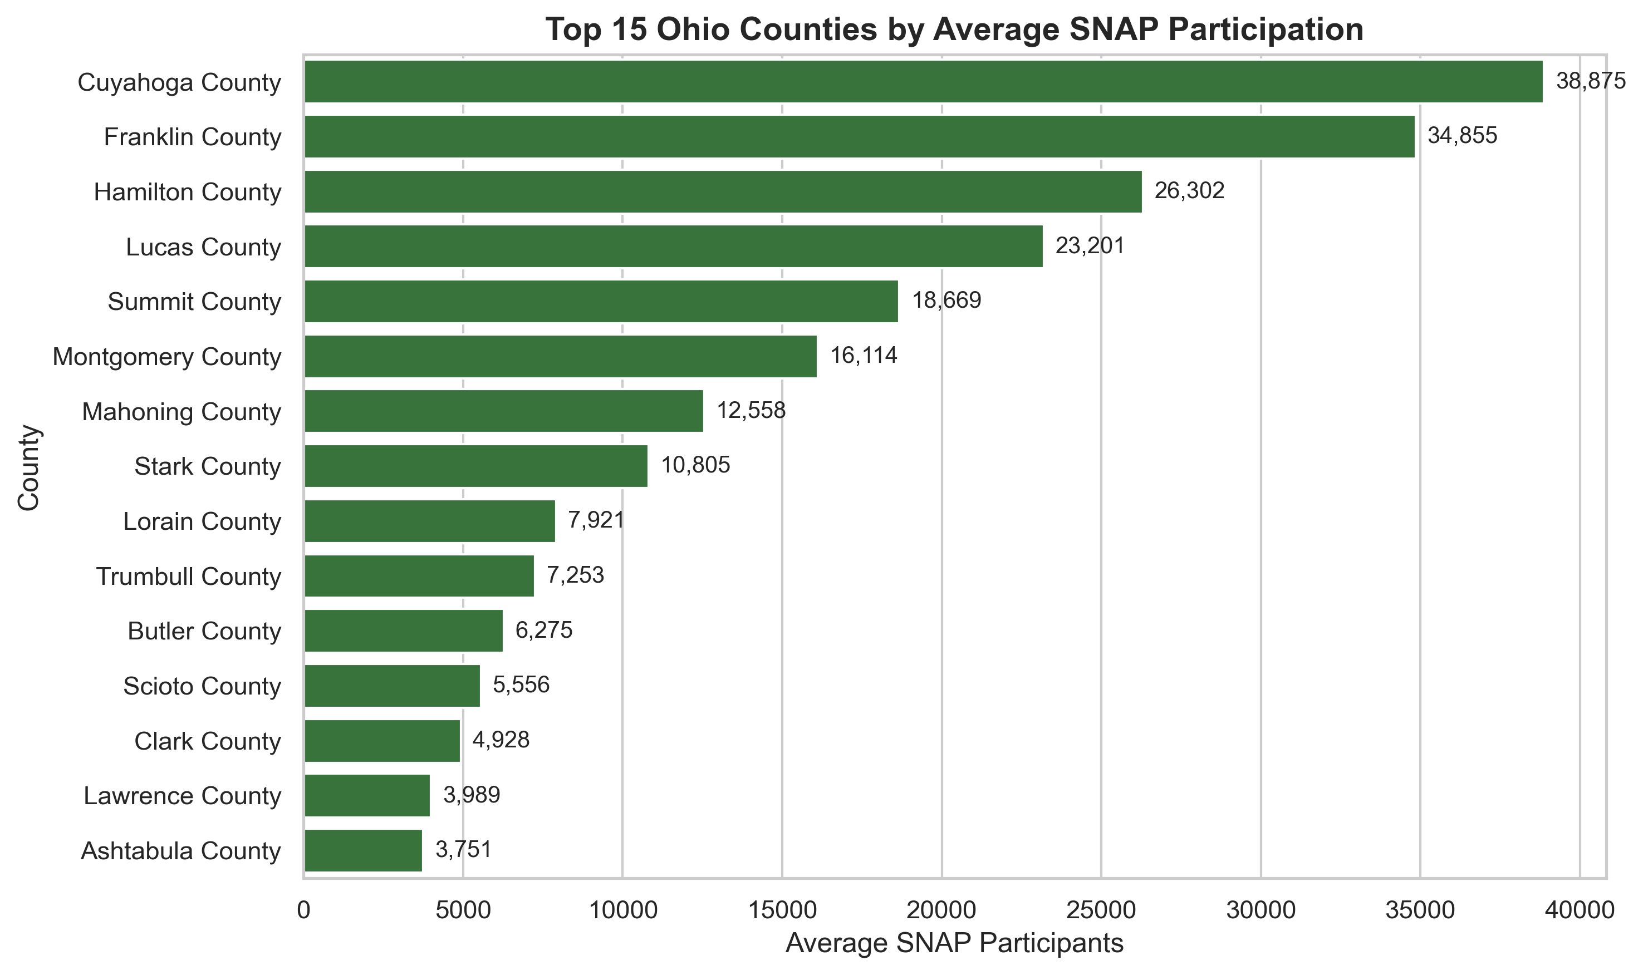
Notes:
Some urban counties in Ohio such as Cuyahoga, Franklin, and Hamilton have a relatively higher number of SNAP participants than other Ohio counties.

Slide 7
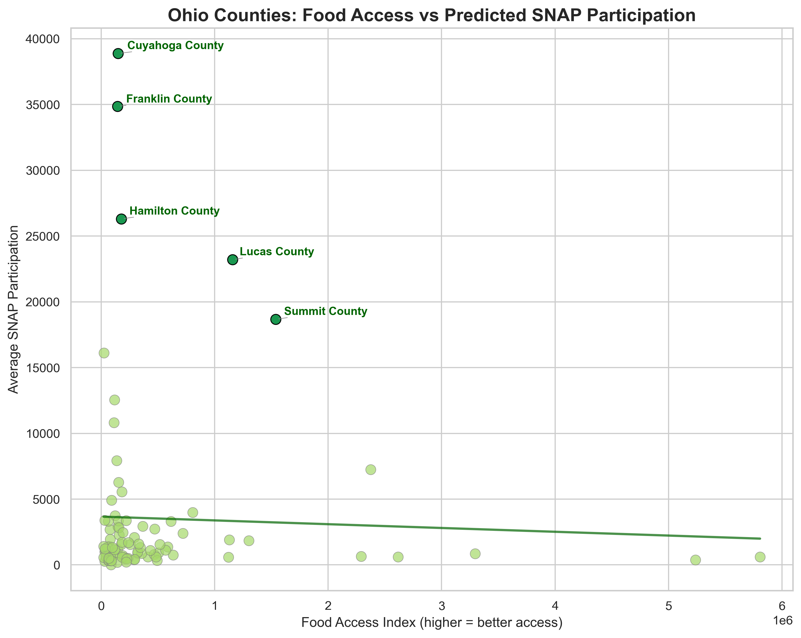
Notes:
This trend line on this chart shows that better access to nutritional food sources are correlated with lower SNAP participation rates. These urban pockets throughout Ohio should be engaged to develop better access to food for the communities in one effort to reduce the need for federal supplemental funds.

Slide 8
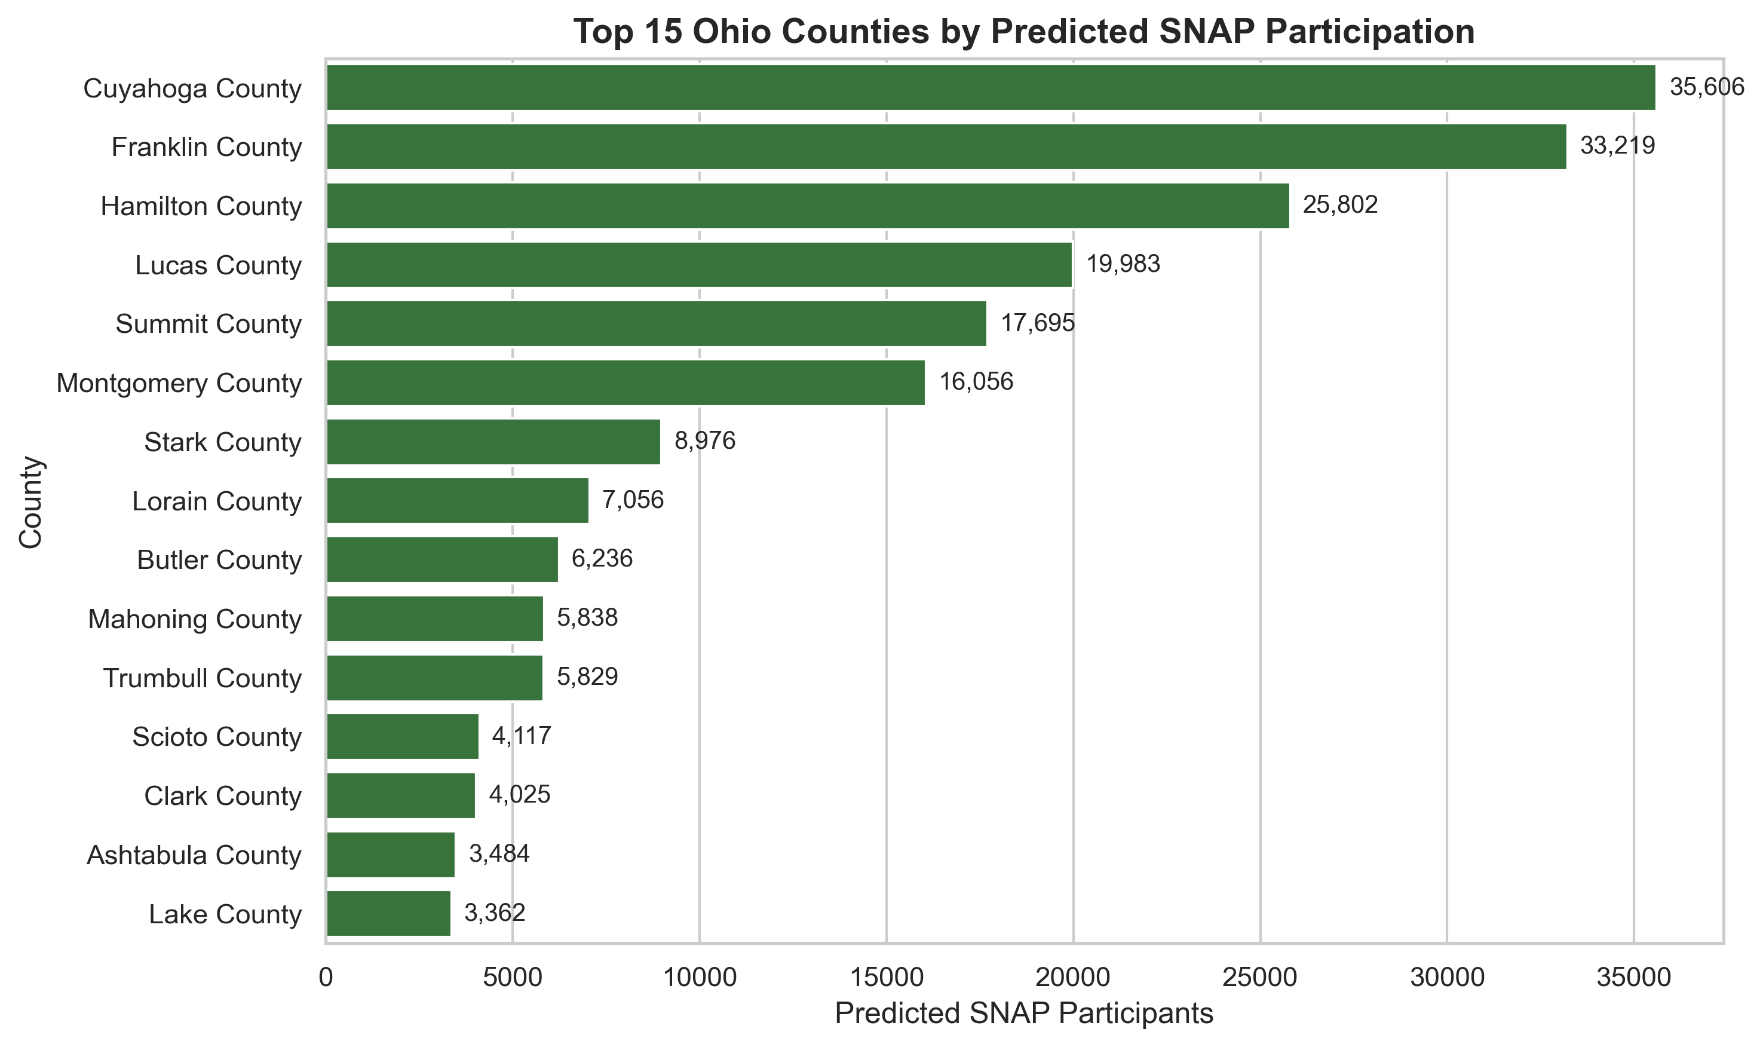
Notes:
The top 3 counties (Cuyahoga, Franklin, and Hamilton) remained in the same ranked order, but we can see some other counties change order and see that Lake County is now in the top 15 counties where it was not before. This will allow for proactively planning to see which counties needs are on the rise and ensure they are allocated resources toward better food access and SNAP benefits to those counties.

Slide 9
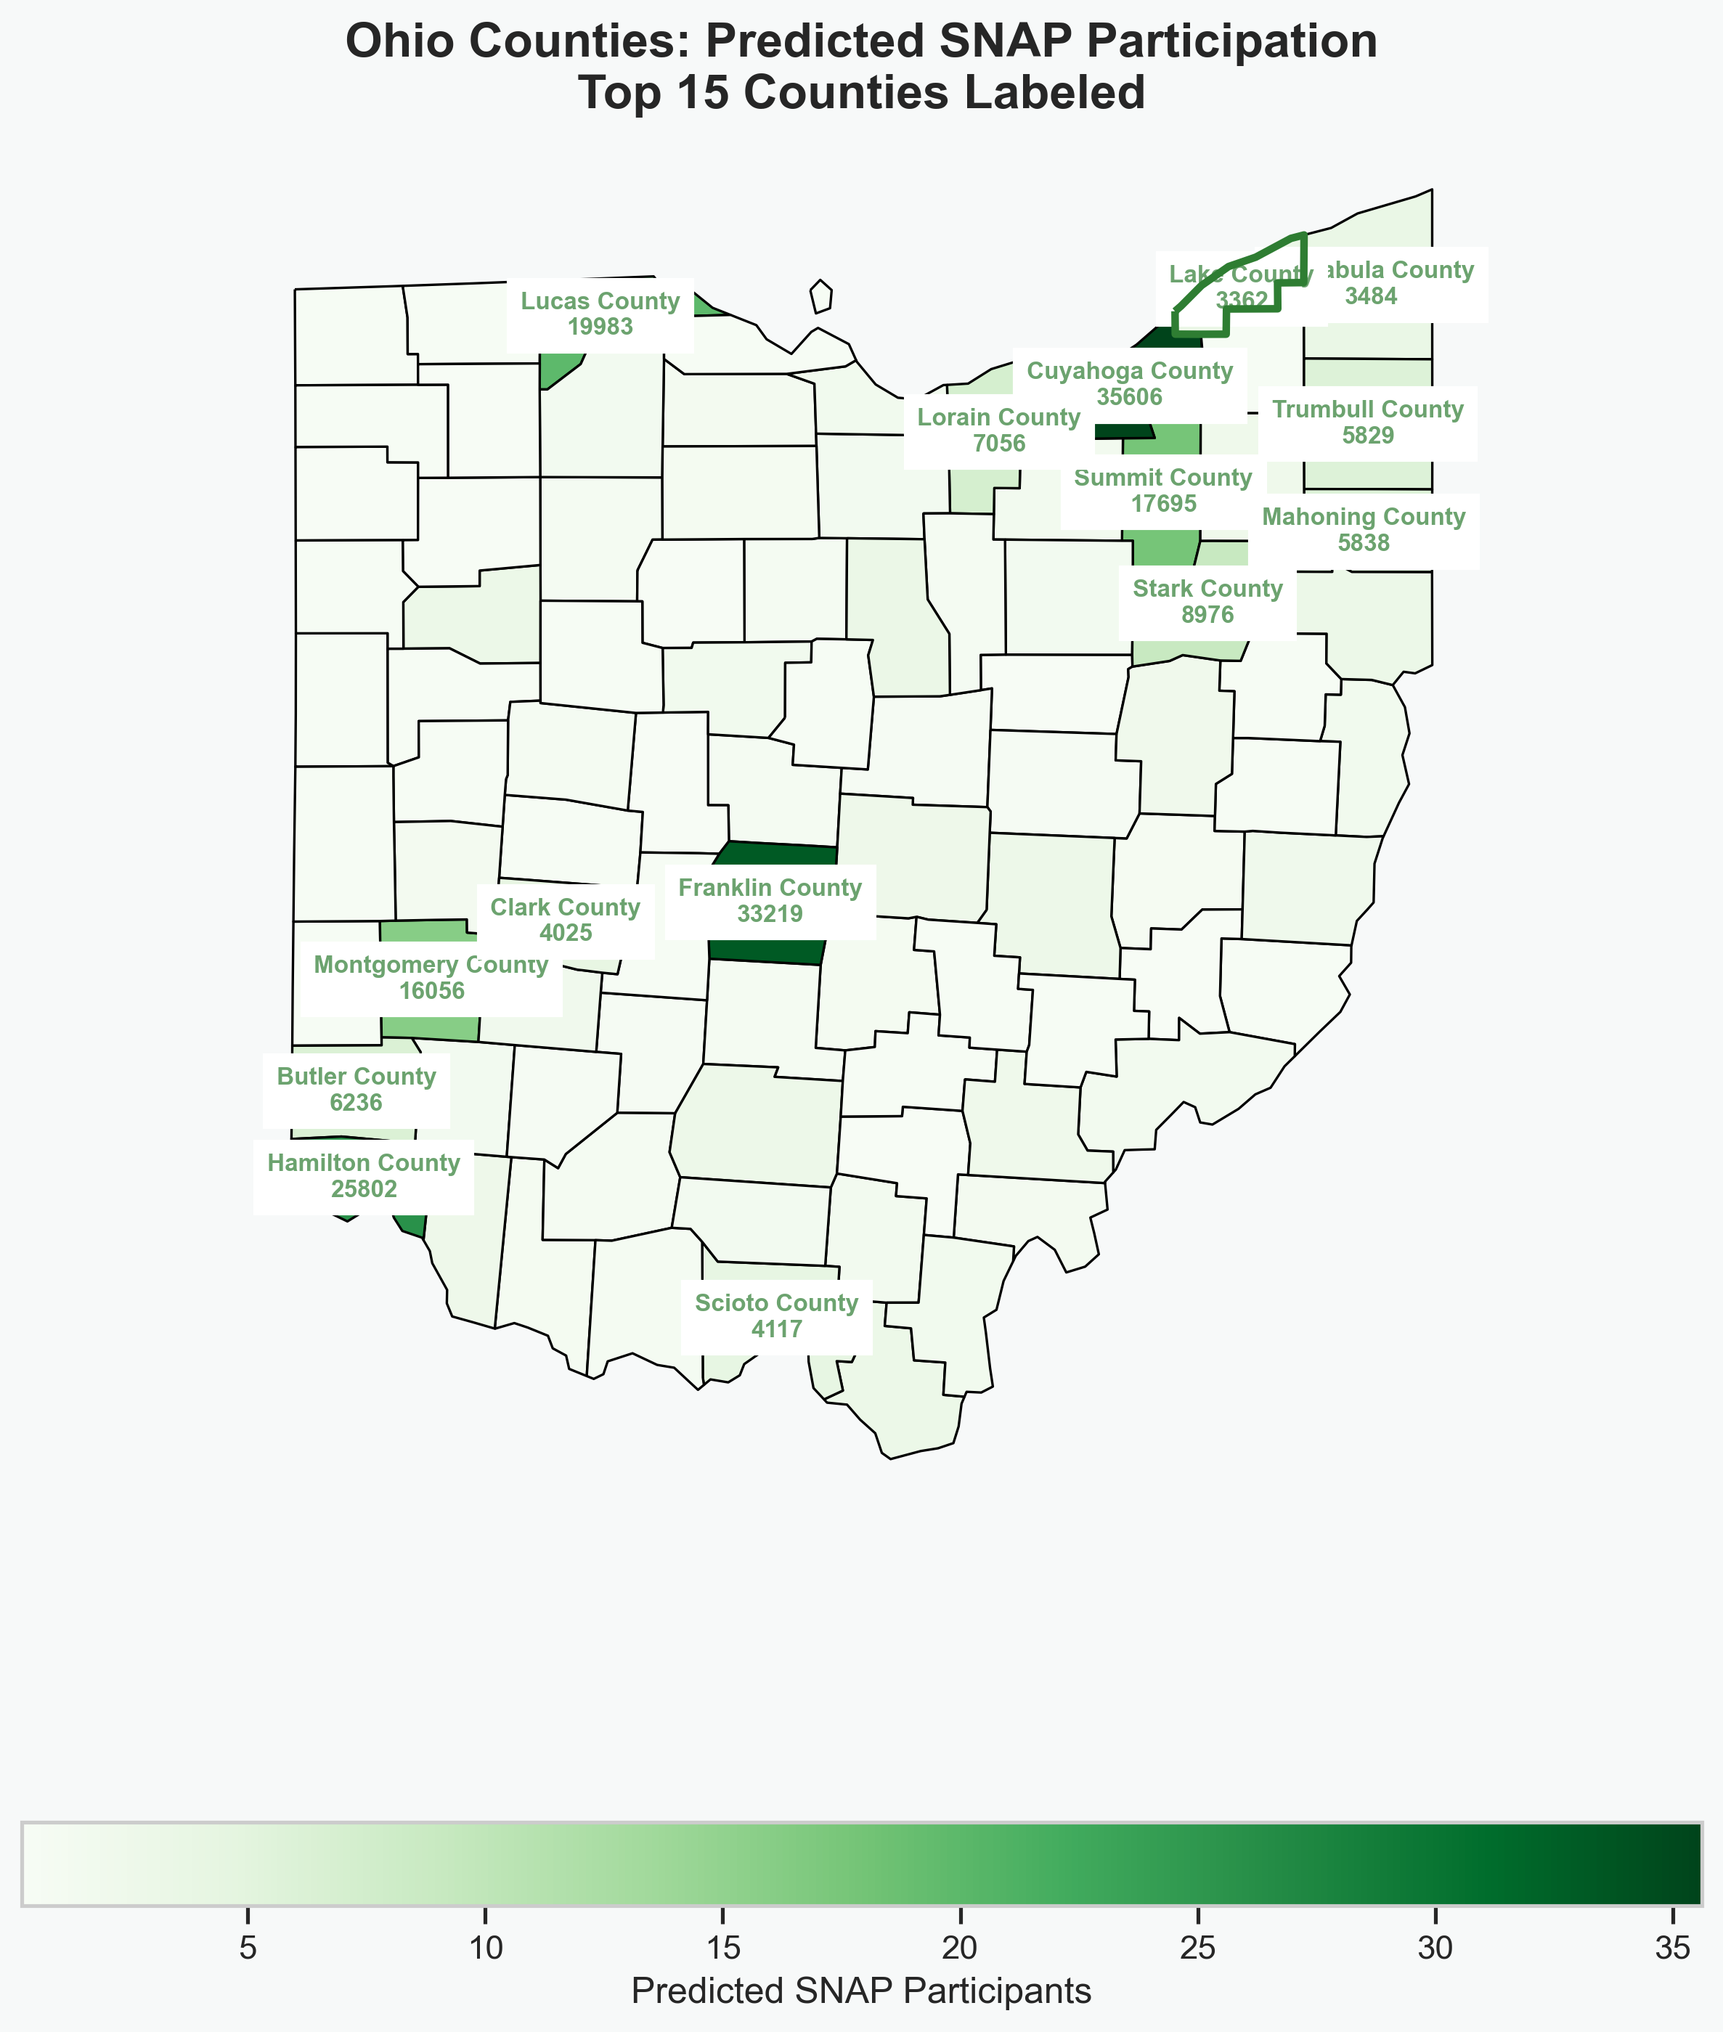
Notes:
We can see that Lake County is adjacent to Cuyahoga county, which is the top Ohio county with SNAP Participation. This rise in food scarcity risk may indicate that this county should be reviewed for food assistance and programs to bring access to food closer.

Slide 10
Anticipated Outcomes
Identify counties to prioritize for SNAP benefits
Allocation of funding for community initiatives to increase access to nutritional food
Regular monitoring by Ohio agencies
Transparent and timely communication between state and county to align planning
Expand to other states nationwide
Ensure most vulnerable communities are receiving assistance
Notes:
The anticipated outcomes for this project analysis are to prioritize counties predicted to have a food scarcity need for SNAP benefit distribution, set aside funding in counties with limited access to nutritional food in prevention efforts to reduce the need to participant in SNAP., work with state agencies to establish regularly monitoring of food assistance needs per county, while also pushing for development of easier access to food in those areas at high risk of food scarcity. Communities should also be engaged in developing better access to nutritional food resources. Ultimately, we want the communities that are most vulnerable to receive the funding they need.

Slide 11
Appendix
Anticipated Questions / Answers
What motivated this project and why focus specifically on Ohio? Ohio represents both urban and rural areas and provides some insight into national food needs since it ranks close to the national average for SNAP participation.
What data sources were used and how reliable are they? Data was obtained from free publicly available government websites from the United State Department of Agriculture (USDA). The datasets are updated periodically to remain accurate and relevant.
How was the Food Access Index constructed and what does a higher value mean? This was created by averaging several SNAP related indicators at the county level. Higher index values indicate less access to nutritional, affordable food.
What predictive model was used and why was it chosen? A Random Forest Regressor can handle complex relationships and both categorical and numerical data. It was chosen due to its ability to distinguish important features to make predictions.
How accurate is the model? The R-squared score of 0.652 indicates that the previous (lag) SNAP participation features along with the Food Access Index accounts for a moderate amount of the variability in SNAP participation.

Slide 12
Appendix continued
Anticipated Questions / Answers Continued
What were the main insights gained from Ohio’s access to food compared to other states? We can refer to the boxplot, which shows that Ohio’s food access index is higher than the national average indicating they have slightly less access to nutritional food. This was the expectation given the diverse regions in Ohio where some may have less access and transportation barriers than others
How do food access and SNAP participation correlate to each other in Ohio? The scatterplot of Ohio shows as access to food is limited (index gets higher), SNAP participation also increases which is expected.
What are some limitations of the study? The food access index is an average of several factors and SNAP related indicators which can obscure real predictive value if too much unhandled noise in the chosen factors. This is used as a guide to help prediction.
How can state agencies use the results from this study? The agencies can prioritize funding and enhance community engagement to provide better access to food. It can also reveal counties that may have rising food scarcity that were not previously known.
What are some future enhancements for improving this analysis? Time series modeling to capture changes in SNAP participation over time and choosing best features to use in the food access index to make the model more robust.

Slide 13
Appendix continued
Food Scarcity Code in Github Repository
Click paper to review White Paper for Project

